Slide 1
Your ad could be there …

Slide 2

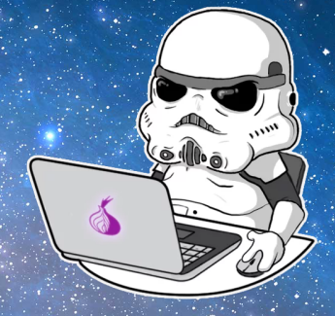



Intro: death spiral

Slide 3

Intro: death spiral

Slide 4
Intro: death spiral
Every industry and company that is not bringing software to the core of their business will be disrupted.
Jeffrey Immelt, General Electrics CEO

Slide 5

devOps or welcome to the other side
DevOps in nutshell or welcome to the other side
Abandon hope all ye who enter here

Slide 6
Hello! My name is …
… is Vladislav Milevskiy
+10 years in IT
- dev :: object pascal; PHP; C#; java; js
- devOps :: CI/CD pipelines; dep/inf management
- PROD support :: L3&L4!
Main intentions for this presentation is …
… have simple training material about devOps core values

Slide 7


What is devOps?
is a software engineering culture and practice that aims at unifying software development (dev) and software operation (ops).
Term was created by Patrick Debois as a result of:
- 2008 Agile conference in Toronto (infrastructure as code)
- 2009 Velocity conference in San Jose (Flickr: 10+ Deploys Per Day)
- 2009 first devOps days in Ghent, Belgium
Gene Kim – author of a few interesting books:
- The Phoenix Project
- The DevOps handbook
- Beyond the Phoenix Project

Slide 8
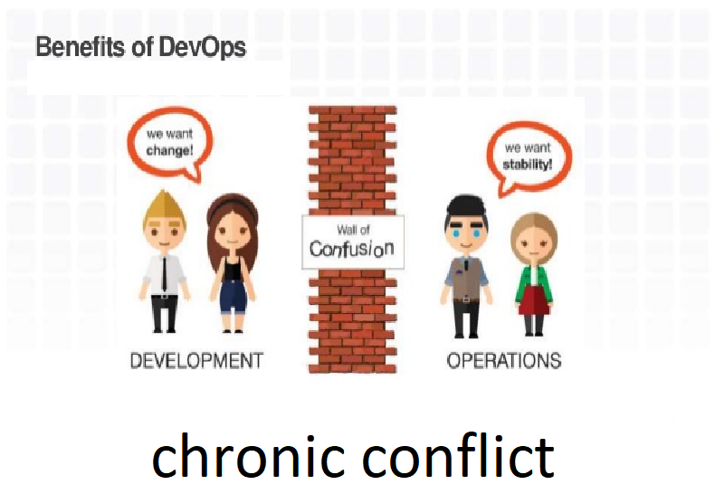

What is devOps?

Slide 9
Why do we need it?
Management:
Win the competition
Beat the death spiral
Increase company value
Engineers:
Avoid burnouts
Most likely you are already doing some of it
Keep your work-life balance promises
Enjoy your work
Customers:
Make proper decision about product or service
Make proper decision about investments

Slide 10

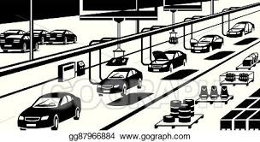
How to do it?
Continuous:
Improvement (20% rule)
Integration – source control systems (git)
Delivery – delivery pipeline (jenkins)
Testing – integration and unit tests
Security – code testing for possible problems (static code analysis)

Slide 11
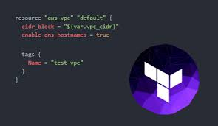

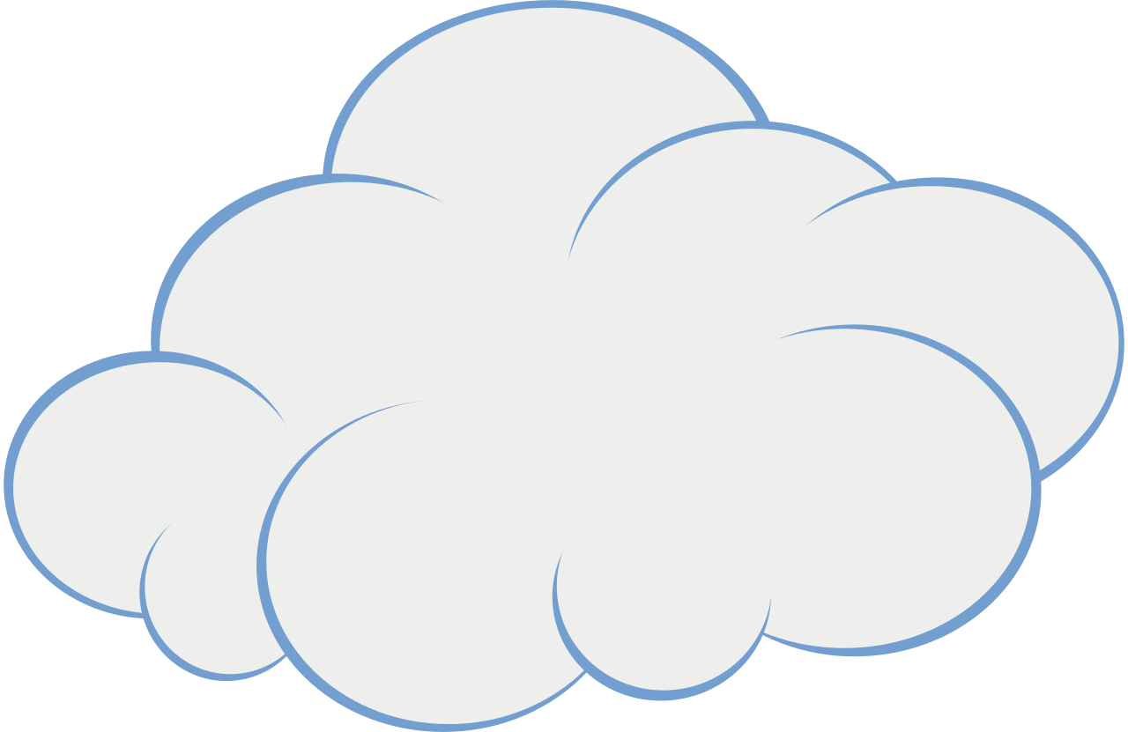
How to do it?
Infrastructure as code (IAC)
idea is that you write and execute code to define, deploy and update your infrastructure
Types of IAC tools:
Ad-hoc (latin:: for this purpose)
scripts (in bash we trust)
Configuration management tools
(puppet, chef, ansible)
Server templating tools
(docker, packer, vagrant)
Server provisioning tools
(terraform, cloudify, power shell, cloud formation)

Slide 12
How to do it?
Infrastructure as code

Slide 13
How to do it?
Infrastructure as code – rise of public cloud providers
You go back in time a hundred years, if you wanted to have electricity, you had to build your own little electric power plant, and a lot of factories did this. As soon as the electric-power grid came online, they dumped their electric-power generator, and they started buying power off the grid. It just makes more sense. And that’s what is starting to happen with infrastructure computing.
Jeff Bezos, Everything Store

Slide 14

How to do it?
Monitoring, statistics, metrics
Cultural high trust environment
War games
Blameless post-mortems
Active work on soft skills

Slide 15
Show me the code …
resource "azurerm_resource_group" "az_cace_dev00_resourcegroup01" {
name = "az_cace_dev00_resourcegroup01"
location = "canadacentral"
}
# terraform init
# terraform plan
# terraform apply
# terraform destroy
# terraform graph

Slide 16
More fun … trade info
mongo DB
trade stats
IEX data
trade stats
trade stats
load balancer

Slide 17
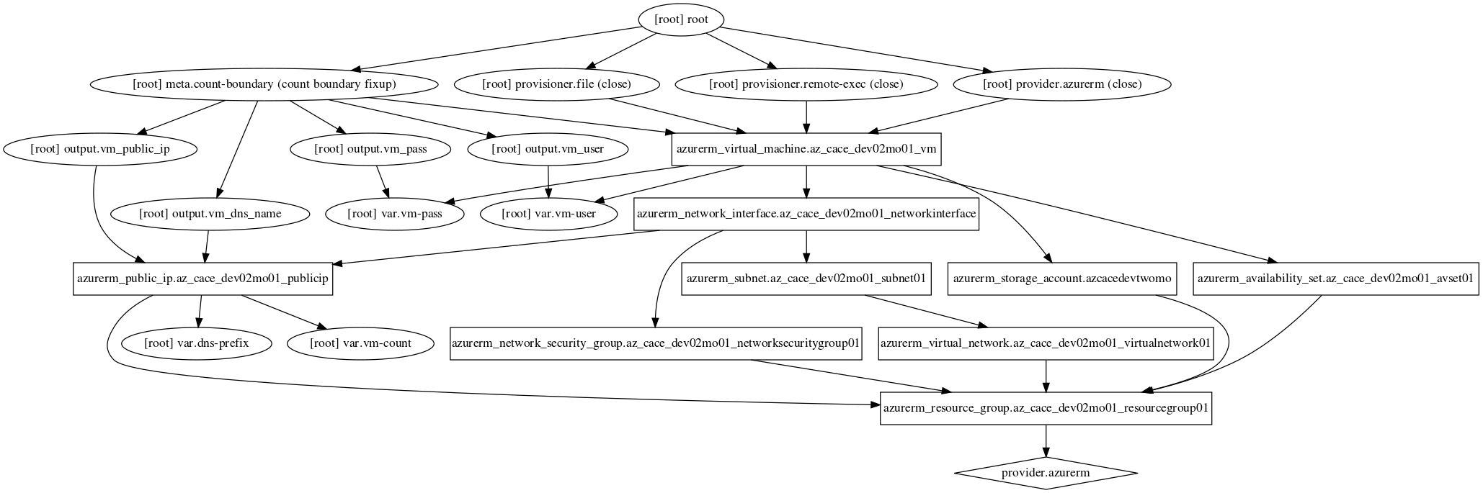
More fun … with mongo

Slide 18
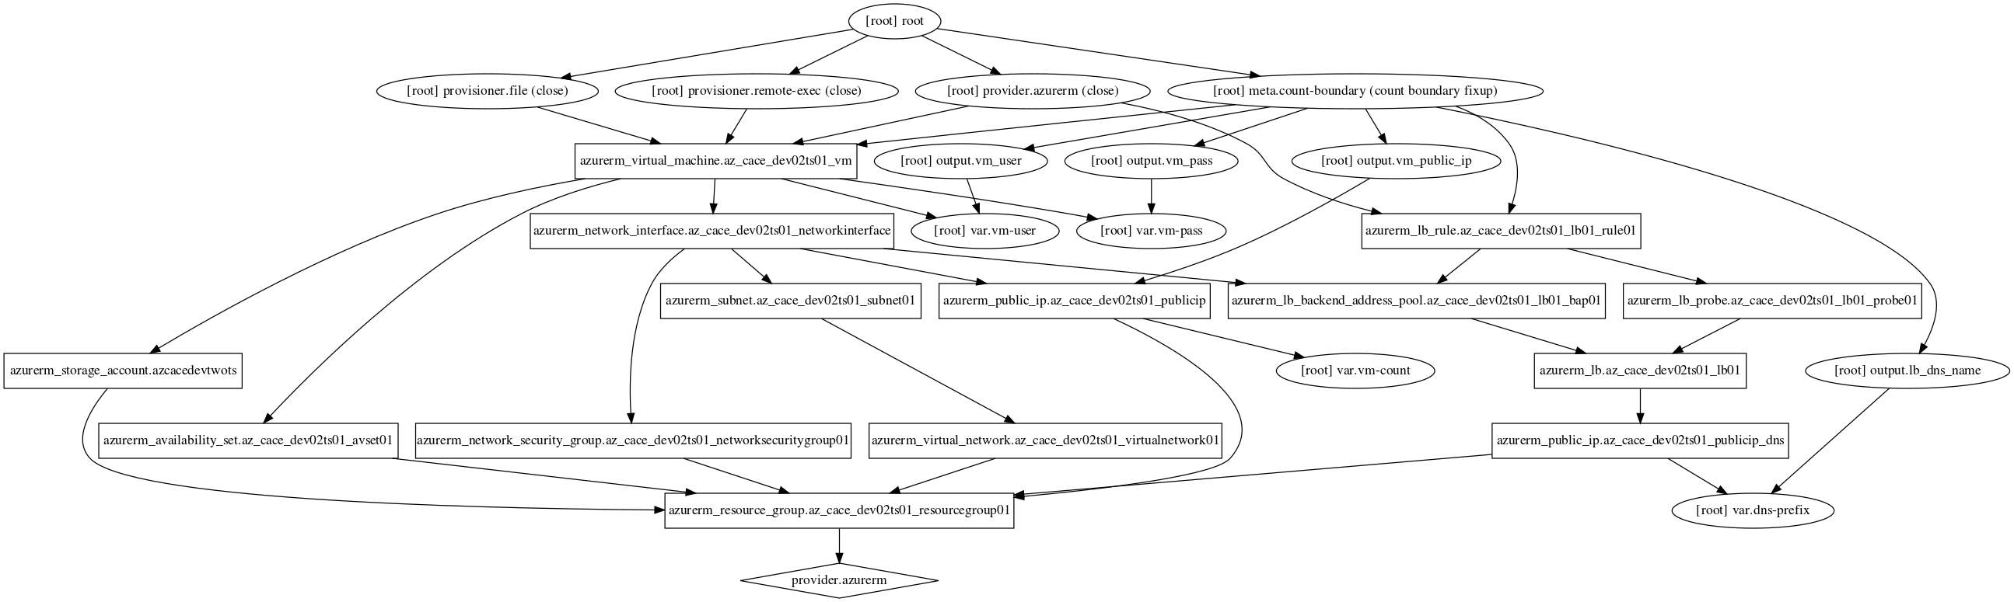
More fun … with java

